Slide 1
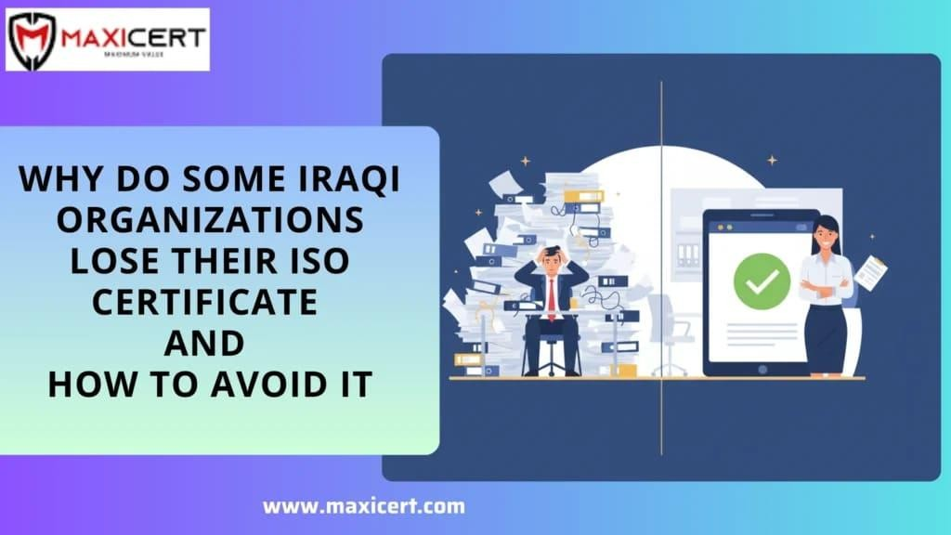
Why Do Some Iraqi Organizations Lose Their ISO Certiﬁcate and How to Avoid It
Introduction
Many organizations in Iraq work hard to achieve ISO certiﬁcation. The effort, documentation, and audits take time, resources, and commitment. Yet, a surprising number of companies lose their ISO certiﬁcation a few years later not because they stopped caring, but because the system quietly stopped working.
The truth is simple: getting ISO certiﬁed is one thing; maintaining it is another.
This article explains why ISO certiﬁcates are sometimes withdrawn in Iraq, what usually goes wrong after certiﬁcation, and how organizations can avoid repeating the same
mistakes.

Slide 2
Why ISO Certiﬁcation Is Lost After Approval
In most cases, certiﬁcation is not suddenly lost .Here are the most common reasons.
Systems Stop Reflecting Real Work
One of the biggest reasons organizations lose certiﬁcation is misalignment between documentation and daily operations.
After certiﬁcation:
Procedures are no longer updated
Employees return to old habits
Documents exist only for audit purposes
When surveillance audits happen, auditors quickly notice when systems exist only on paper. This gap between “what’s written” and “what’s done” often leads to major
nonconformities.
Internal Audits Become a Formality
Internal audits are meant to identify problems early. But in many Iraqi organizations, they turn into a checkbox activity.
Common issues include:
Audits done in a rush
Same ﬁndings repeated every year
Limited follow-up on corrective actions
Without honest internal audits, problems stay hidden until an external auditor points them out often too late.
Staff Awareness Slowly Declines
When ISO is treated as a one-time project, staff engagement fades.
New employees are not trained properly. Existing staff forget procedures. Over time, knowledge becomes fragmented.
This leads to:

Slide 3
Inconsistent practices
Unclear responsibilities
Increased audit ﬁndings
ISO systems rely heavily on people, not just documents.
Changes Are Not Properly Managed
Organizations evolve new clients, new services, new locations.
But many fail to update their ISO systems when these changes happen. Common oversights include:
Not revising risk assessments
Outdated process maps
Unapproved changes to workﬂows
Auditors often ﬁnd this as a serious issue because it shows the system is no longer being monitored.
Lack of Ongoing Leadership Support
ISO certiﬁcation needs ongoing leadership involvement. When management attention fades after certiﬁcation:
Reviews stop happening regularly
Improvement actions are delayed
Teams lose motivation
Without leadership direction, the system slowly weakens.
A Common Example from Iraq
A mid-sized service company in Iraq achieved ISO certiﬁcation with strong preparation. But over time, management shifted focus to operations only.
Internal audits were skipped. New staff were not trained. Documentation wasn’t updated.

Slide 4
How to Prevent Losing Your ISO Certiﬁcation
Organizations that maintain certiﬁcation successfully tend to do a few things consistently:
When the surveillance audit arrived, the company faced multiple nonconformities and nearly lost its certiﬁcate. Only after rebuilding internal processes and assigning clear responsibilities were they able to recover.
Keep procedures aligned with real daily work
Conduct meaningful internal audits
Train employees regularly
Review risks and changes on time
Treat ISO as a management system, not a one-time task
Simple Comparison: Strong vs Weak ISO Management
Area | Weak ISO Practice | Strong ISO Practice
Documentation | Updated only for audits | Updated as work evolves
Internal audits | Rushed or skipped | Planned and honest
Staff awareness | Limited to managers | Shared across teams

Slide 5
How Maxicert’sISO Consultants Can Help
Leadership role | Minimal involvement | Active oversight
Certiﬁcation status | At risk | Stable and maintained
Many Iraqi organizations work with experienced ISO consultants to avoid common mistakes.
Maxicert provides support that includes:
Aligning documentation with actual operations
Training teams in simple, practical terms
Preparing for audits without stress
Building systems that stay effective long-term
The goal is not just to pass an audit but to keep the certiﬁcation year after year.
Want to build an Environmental Management System (EMS) That Actually Works?
Conclusion
Most companies in Iraq don’t lose their ISO certiﬁcate because they fail an audit. They lose it because the system slowly stops matching how work is really done.
ISO doesn’t need to be perfect, it just needs to be followed. When procedures reﬂect daily work and management stays involved, keeping certiﬁcation becomes easy.
Want to get ISO certiﬁcation or keep your existing ISO certiﬁcate safe in Iraq? Talk to Maxicert today for simple, practical ISO support that works.

